Slide 1
Session 20: Generics and Legacy Classes Module 3.2: Core Java

Slide 2
Learning Objectives
At the end of the session successful participants will be able to
Explain about Generic Collections
Explain about Legacy classes and interfaces in Collection API
Work with Utility Classes
Use of Some important utility classes(StringBuffer, Date, Calendar,
Properties)

Slide 3




Collection Framework
Generic Type
All collection implementations are declared to hold Object type .
We can put anything in any Collection;
Collections are declared as Collection<Object>.
Collection
Collection<Book>
Compile Time Error
Object
Book
Without generics, the compiler would happily let you put Mobile into an Collection that was supposed to hold any Objects.
With generics, you can create type-safe collections where more problems are caught at compile-time instead of runtime.

Slide 4
Legacy Classes and Interfaces
Early version of java did not include the Collection framework.
It only defined several classes and interface that provide method for storing objects.
When Collection framework were added in J2SE 1.2, the original classes were reengineered to support the collection interface. These classes are also known as Legacy classes
All legacy classes and interface were redesign by JDK 5 to support Generics.

Slide 5
Legacy Classes and Interfaces
The following are the legacy classes defined by java.util package
Dictionary
Hashtable
Properties
Stack
Vector
Note: There is only one legacy interface called Enumeration

Slide 6
Collection Framework
Utilities
General Purpose Implementations
Perform useful computations, such as:
searching
sorting, on objects,.
Implements collection interfaces.
In essence, algorithms are reusable functionality.
The two utility classes are:
java.util.Collections
java.util.Arrays

Slide 7
Collection Framework
Collection Framework
Utilities
Collections
Pieces of reusable functionality provided by the Java platform.
Consists exclusively of static methods that operate on or return collections.
Contains polymorphic algorithms that operate on collections.
Collections can hold Objects but not primitives.

Slide 8
Collection Framework
Example with Collections
1 2 3 4 5 6 7 8 9 10 11 12 13 14 15 16 17 18 19 20 21 22 23 24 25 26 27 28 29 30 31 | import java.util.ArrayList; import java.util.Collections; import java.util.Iterator; public class EmpList { public static void view(Iterator<Employee> it){ while(it.hasNext()) System.out.println(it.next()); } public static void main(String[] args) { ArrayList<Employee> al=new ArrayList<Employee>(); al.add(new Employee("Harshad", 3948, 2012, 29839.00)); al.add(new Employee("Vijay", 5940, 2010, 23239.00)); al.add(new Employee("Kumar", 837, 2010,83493.00)); al.add(new Employee("Arun", 9834, 2008, 29382.00)); al.add(new Employee("Vamsi", 8989, 2009, 45495.00)); al.add(new Employee("Rama", 121, 2005, 394839.00)); al.add(new Employee("Kiran", 2983, 2006, 293829.00)); al.add(new Employee("Arun", 9834, 2008, 29382.00)); view(al.iterator()); Collections.sort(al); System.out.println("Sorted Collection: "); view(al.iterator()); SalarySort ss=new SalarySort(); Collections.sort(al,ss); System.out.println("Salary Sorted Collection: "); view(al.iterator()); } }
Sort() of Collections class will sorts the Collection using Comparable or Comparator implementations
Sort() of Collections class will sorts the Collection using Comparable or Comparator implementations

Slide 9
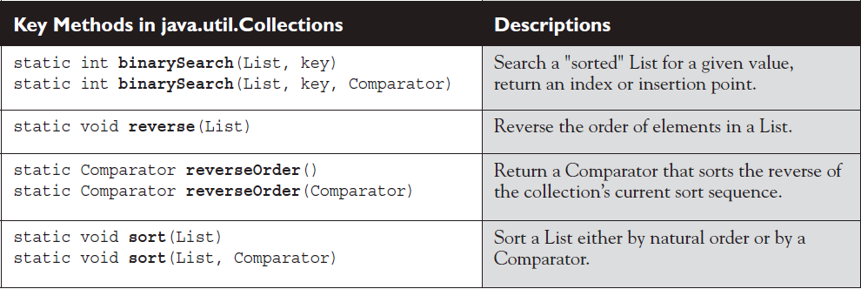
Collection Framework
Methods in Collections
Key Methods in java.util.Collections | Descriptions

Slide 10
Collection Framework
Utilities
Arrays
Contains various methods for manipulating and working on arrays such as:
Sorting
Searching
Contains a static factory that allows arrays to be viewed as lists.

Slide 11
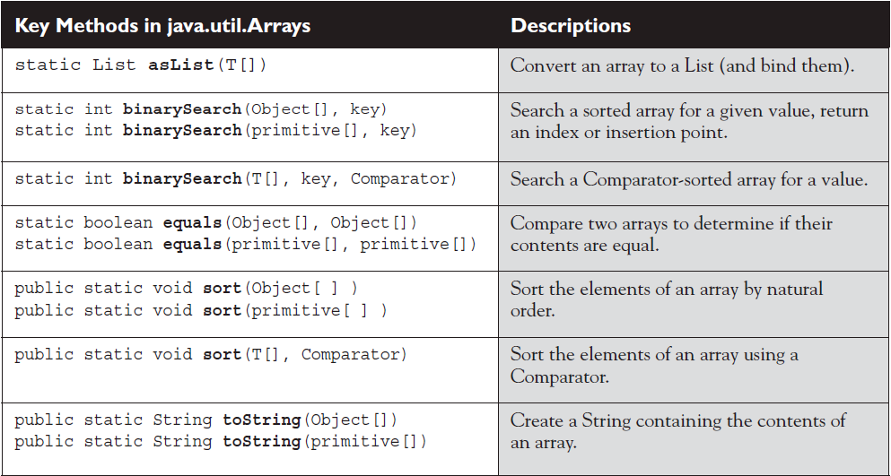
Collection Framework
Methods in Arrays
Key Methods in java.util.Arrays | Descriptions

Slide 12
String Buffer
A StringBuffer is like a String, but it is mutable.
String is fixed length, in contrast, StringBuffer is growable and writable using cetain method calls.
Characters in StringBuffer can be inserted, appended, added, deleted anywhere and the size of the StringBuffer will automatically grow or shrink to make room for this.
StringBuffer defines three constructors:
StringBuffer()
StringBuffer(int size)
StringBuffer(String str)

Slide 13
Important methods in String Buffer:
The important methods on a StringBuffer are the append and insert methods, which are overloaded so as to accept data of any type.
Below are three overloaded append methods:
1) StringBuffer append(String str)
2) StringBuffer append(int num)
3) StringBuffer append(char ch)
4)StringBuffer append(int index,String str)
The append method always adds the specified characters at the end of the string if the index is not specified.

Slide 14
Important methods in String Buffer:
Below is the syntax for insert method:
StringBuffer insert(int index, String str)
The insert method adds the characters at the specified point. Here index specifies the point at which the string will be inserted into the invoking StringBuffer object.
delete()- Removes all the characters of the StringBuffer from the specified start to end position.
public StringBuffer delete(int start, int end)

Slide 15
Date Object
Utility Classes
Date object represents a specific instance in time with millisecond precision
Date class is intended to reflect coordinated universal time (UTC)
A Date Represents the number of milliseconds since the standard base time known as “the epoch” or January 1, 1970, 00:00:00 GMT
Package - java.util.Date
Most Date method have been deprecated, Calendar object is used instead

Slide 16
Calendar
Utility Classes
Abstract class
Package – java.util.Calendar
GregorianCalendar is the only standard concrete class
Object factory used to create a Calendar instance
static Calendar getInstance();
Calendar object takes care of date and time handling details in order to support the conventions and calendar type of the user

Slide 17
Calendar Objects
Utility Classes
Can set and get integer values for year, month, day, hour, minute, day of week, etc.
int get(int field)
void set(int field, int value)
Field is the numeric representation of the calendar field to set or get
You have to know what the value of field should be to get what you want.
Field is a constant class variable defined within the Calendar class

Slide 18
Calendar Fields
Utility Classes
Calendar.DATE Calendar.MONTH
Calendar.YEAR Calendar.DAY_OF_WEEK
Calendar.DAY_OF_MONTH Calendar.DAY_OF_YEAR
Calendar.HOUR Calendar.MINUTE
Calendar.SECOND Calendar.MILLISECOND
Calendar.AM Calendar.PM
Calendar.JANUARY Calendar.FEBRAURY
Many more…

Slide 19
Calendar Field Values
Utility Classes
Calendar.Month
January is 0
December is 11
Undecember is 12 - Lunar calendar
Calendar.Date
Same as DAY_OF_MONTH
Starts at 1
Calendar.Day_OF_WEEK
Sunday is 1
Saturday is 7

Slide 20
Calendar Example
Utility Classes
import java.util.*;
class TestCalendar {
static public void main(String []args) {
Calendar c = Calendar.getInstance();
System.out.println("Today is " +
(c.get(Calendar.MONTH)+1) + "/" +
c.get(Calendar.DATE) + "/" +
c.get(Calendar.YEAR));
}
}

Slide 21
Gregorian Calendar
Utility Classes
Package – java.util.GregorianCalendar
Concrete subclass of Calendar that provides the standard calendar used by most of the world
Provides seven constructors that allow GregorianCalendar objects to be created using a combination of different date, time, time zone, and locale values

Slide 22
Gregorian Calendar Example
Utility Classes
import java.util.*;
class TestGCalendar {
static public void main(String []args) {
Calendar gc = new GregorianCalendar(2004, 06, 01);
System.out.println(“Day of year: “ + gc.get(Calendar.DAY_OF_YEAR));
System.out.println(“Week of year: “ + gc.get(Calendar.WEEK_OF_YEAR));
}
}

Slide 23
Date Calculations
Utility Classes
Can add and subtract from dates by using method public void add(int field, int amount)
Examples
Calendar gc = new GregorianCalendar();
gc.add(Calendar.MONTH, 8);//add 8 month
gc.add(Calendar.DATE, 3); //add 3 days
gc.add(Calendar.YEAR, -1); //subtract 1 year
Changes the original date

Slide 24
Date Format
Utility Classes
Abstract class
Package – java.text.DateFormat
Four different pre-defined formats
SHORT - a completely numeric representation for a date or a time such as 5/1/05 or 8:00am
MEDIUM - a longer representation such as Apr 1, 2004
LONG - a longer representation than medium such as April 1, 2004
FULL - a comprehensive representation of the date or the time such as Thursday, April 1, 2004

Slide 25
Date Format Example
Utility Classes
public static void main(String [] args) {
Calendar gc = new GregorianCalendar();
// try with default Locale
DateFormat.getDateInstance(DateFormat.SHORT). format(gc.getTime());
DateFormat.getDateInstance(DateFormat.MEDIUM).
format(gc.getTime());
DateFormat.getDateInstance(DateFormat.LONG). format(gc.getTime());
DateFormat.getDateInstance(DateFormat.FULL). format(gc.getTime());
}
5/1/04
Apr 1, 2004
April 1, 2004
Thursday, April 1, 2003

Slide 26
Date Format Example – Local for Germany
Utility Classes
public static void main(String [] args) {
Calendar gc = new GregorianCalendar();
DateFormat.getDateInstance(DateFormat.SHORT, Locale.GERMANY).format(gc.getTime());
DateFormat.getDateInstance(DateFormat.MEDIUM, Locale.GERMANY).format(gc.getTime());
DateFormat.getDateInstance(DateFormat.LONG, Locale.GERMANY).format(gc.getTime());
DateFormat.getDateInstance(DateFormat.FULL, Locale.GERMANY).format(gc.getTime());
}
01.04.04
01.04.2004
1. April 2004
Donnerstag, 1. April 2004

Slide 27
Simple Date Format
Utility Classes
Concrete class
Package – java.text.SimpleDateFormat
Used for formatting and parsing dates in a locale-sensitive manner
Date to Text - Formatting
Text to Date - Parsing
Allows user defined patterns for dates and times
Create pattern string to specify how to format or parse date and time values

Slide 28
Pattern Strings
Utility Classes
Unquoted letters from 'A' to 'Z' and from 'a' to 'z' are interpreted as pattern letters
All other characters are not interpreted
Text can be quoted using single quotes (') to avoid interpretation.
Pattern letters are repeated, as their number determines the exact presentation

Slide 29
Sampling of Pattern Letters
Utility Classes
Letter | Component | Presentation | Examples*
y | Year | Year | 2004; 04
M | Month in year | Month | April; Apr; 04
D | Day in year | Number | 92
d | Day in month | Number | 01; 1
H | Hour in day (0-23) | Number | 18
k | Hour in day (1-24) | Number | 18
K | Hour in am/pm (0-11) | Number | 6; 06
h | Hour in am/pm (1-12) | Number | 6; 06
m | Minute in hour | Number | 47
S | Second in minute | Number | 30
S | Milliseconds | Number | 550; 00550
a | Am/pm marker | Text | PM
*Examples for April 1, 2004 6:47pm

Slide 30
Pattern Strings Examples
Utility Classes
Pattern | Result
yyyy/MM/dd hh:mm:ss:SSSS | 2004/04/01 06:47:30:0500
MMM. dd, yy 'at' HH:mm:ss | Apr. 01, 04 at 16:47:30
EEE, MMM d, ''yy | Thu, Apr 1, '04
EEEEEE, MMMMM dd, yyyy | Thursday, April 01, 2004
yyyyy.MMMMM.dd hh:mm aaa | 02004.April.01 08:35 PM
hh 'o''clock' a, zzzz | 06 o'clock PM, Central Standard Time
yyyyMMddhh:mm:ss:SSS | 2004040108:38:37:480
*Examples for April 1, 2004 6:47pm

Slide 31
System Properties
Utility Classes
System properties are a feature that replaces the concept of environment variables (Which are platform-specific).
The System.getProperties method returns a Properties object.
The getProperty method returns a String representing the value of the name property.
Use the –D option on the command line to include a new property.

Slide 32
The Properties Class
Utility Classes
The Propertiesclass implements a mapping of names to values (a String-to-String map).
The propertyNames method returns an Enumeration of all property names.
The getProperty method returns a String representing the value of the named property.
You can also read and write a properties collection into a file using load and store.

Slide 33
The Properties Class
Utility Classes
import java.util.Properties;
Import java.util.Enumeration;
public class TestProperties{
public static void main(String[] args){
Properties props = System.getProperties();
props.list(System.out);
}
}

Slide 34
The Properties Class
Utility Classes
The following is an example test run of this program:
java –DmyProp = theValue TestProperties
The following is the (partial) output:
java.runtime.name=Java(TM) SE Runtime Environment
sun.boot.library.parth = C:\jse\jdk1.6.0\jre\bin
java.vm.version=1.6.0-b105
java.vm.vendor=Sun Microsystems Inc.
java.vm.name=java HotSpot(TM) Client VM
file.encoding.pkg=sun.io
user.country=US
myProp=theValue

